Slide 1

Test-driven Development with JavaScript. An introduction
REUTERS / Firstname Lastname
2016 London Technology Unconference
Sydney opera house

Slide 2
AGENDER

Slide 3
Our Agenda for the session
Intro to TDD / BDD
What is Unit Testing?
JavaScript Unit Testing challenges
Advantages of Unit Testing JavaScript code
Writing testable code
Test runners, frameworks and assertion libraries
Setup Mocha
Hands-on, short exercises

Slide 4
Introduction to TDD / BDD

Slide 5
Introduction to TDD / BDD
The idea is that the first thing a developer does is write a test based on the current specification they are working on.
This test should fail as the functionality it relies on does not exist yet. The developer’s job is to then write the simplest code that will make the test pass.
If more specifications exist, write more tests and repeat the cycle refactoring and refining your code as you go. If all the specifications have tests and all the tests pass, you are done. Ship it!
The practice of TDD seems simple, but it represents a fundamental change in the way developers have been trained to approach software development. As a result it takes practice and the first few times using it may seem a bit un-natural

Slide 6
What is Unit Testing?

Slide 7
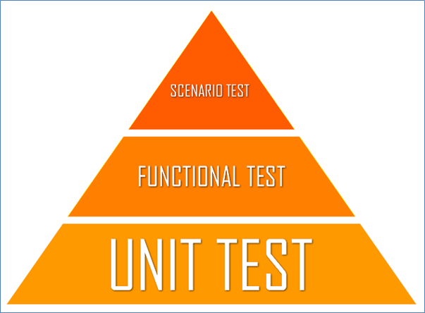
What is Unit Testing?
- given this input, do I get this output? -
When you test your codebase, you take a piece of code — typically a function — and verify it behaves correctly in a specific situation. Unit testing is a structured and automated way of doing this

Slide 8
Unit Testing challenges?

Slide 9
Unit Testing challenges – for the JavaScript Developer
Most where not just trained that way, as the tools for testing of JavaScript code are just recently gaining prominence
Most JavaScript developers over rely on tools such as Chrome Dev. tool or CMD+R and visual testing
Patience and discipline to write a test, especially when you have already “figured it out” mentally
Inevitably it leads to more coding on the developers part and time, test code ends up begin almost, if not more than 60% of the entire code base
Time to market, extra brain power needed i.e. more thought has to be given into what the developer wants to achieve and how each piece fits in the larger application structure

Slide 10
Advantages of Unit Testing

Slide 11
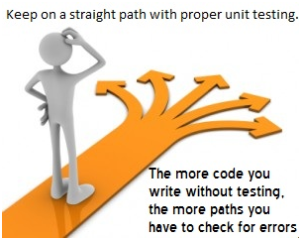
Advantages of Unit Testing
The more tests you write, the bigger the assurance you receive.
You will also have a greater level of confidence in your codebase as you continue to develop it
Immediate feedback that something has changed
A guard against the “ripple effect” -where a change in one section of the application has an effect in another section of the application, especially where there is a lot of code reuse

Slide 12
Writing testable code
BAD: var numbers = [2,3,1,3,5]; $(‘a.sort-numbers’).on(‘click’, function(e){ e.preventDefault(); numbers.sort(); }); | GOOD: var numbers = [2,3,1,3,5]; var sortNumbers = function(e){ e && e.preventDefault(); numbers.sort(); }; $(‘a.sort-numbers’).on(‘click’, sortNumbers);

Slide 13

What is Unit Testing?
“We’ve all been there: that bit of JavaScript functionality that started out as just a handful of lines grows to a dozen, then two dozen, then more. Along the way, a function picks up a few more arguments; a conditional picks up a few more conditions. And then one day, the bug report comes in: something’s broken, and it’s up to us to untangle the mess.” - Rebecca Murphey
Whereas an integration test is interested in a user’s interaction with an app, a unit test is narrowly focused on a small piece of code:
Key point to remember:
When I call a function with a certain input, do I receive the expected output?
Function
Input
Output

Slide 14
What is Unit Testing? – cont’d
Avoid functions that do too much and mix deferent features in one lump, best practice would be to separate these features. A function that handles setup, presentation, Ajax calls and clean up all in one block is a recipe for bugs
Make your code modular, avoid free floating functions, At the least use a closure function. (function(global){ //-- private functions here global.MyModule = { //assessor methods etc}; //making it accessible externally }(this));
Support configurability, rather than hard-coding things. This will prevent us from replicating our entire HTML environment in order to write our tests.
Keep our objects’ methods simple and brief. This will help us keep our tests simple and our code easy to read.
Use constructor functions to create instances of objects. This will make it possible to create “clean” copies of each piece of code for the sake of testing. If using ES6 use classes.

Slide 15
Setup Mocha

Slide 16
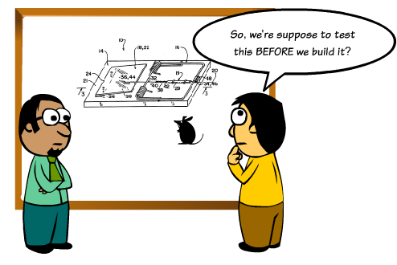
Setup Mocha for the browser
Install Nodejs, npm, gulp
Download or clone repository - github.com/madjava/unconf
Run npm install command

Slide 17
Hands-on, short exercises

Slide 18

Assertion Style
The Expect / Should API covers the BDD assertion styles.
The Assert API covers the TDD assertion style.
Checkout exercises at:- github.com/madjava/unconf

Slide 19
Resources

Slide 20

Resources
mochajs.org
chaijs.com
sinonjs.org

Slide 21
Thank You.
Presenters: Felix Eyetan
Neil Jenner

